Slide 1


Chowgacha UHC model & Jhenaidah Sadar Hospital Development by local initiatives
Dr. Md.Emdadul Haque
Senior Consultant (Obst & Gynae)
Sadar Hospital Jhenaidah

Slide 2
Comparative data of health facilities of different country of the world
SL NO | Country | Per capita health Expenditure per year in 2014 by Govt. ($) | Doctors per 10000 Population | Nurse per 10000 Population
01 | USA | 9403 | 24 | 98
02 | UK | 3935 | 28 | 88
03 | Japan | 3703 | 23 | 114
04 | Malaysia | 456 | 12 | 33
05 | Sri Lanka | 127 | 7 | 19
06 | India | 75 | 7 | 17
07 | Nepal | 40 | 8 | 6
08 | Pakistan | 36 | 8 | 6
09 | Bangladesh | 31 | 3.6 | 2.2
From internet 2015

Slide 3




Community Mobilization Meeting at Lohagara in 1995

Slide 4

50 BEDED UPAZILA HEALTH COMPLEX
Chowgacha, Jessore.

Slide 5
A Sub-district level Women-Friendly Hospital with a Vision …
Maximum utilization of Govt.
resources with
honesty and sincerity
Integrated approach of
Administration, Community
Leaders & Health
Management
Providing Effective and
prompt services
through improved
management system

Slide 6



Blood donation program stared in 16 December, 1996 in Chowgacha UHC
A seminar held on basic information system at Chowgacha Degree College in June, 1997. DC Jessore was the chief guest .

Slide 7





Slide 8





Slide 9
Achievement of Chowgacha Health Complex
From 1996 to 2012, took initiatives to develop Upazilla level standard services in Chowgacha health complex.
In 2010, Chowgacha Health Complex declared as the model upazilla health complex.
  Mobilized 46 additional workers from community (26 volunteer, 12 cleaners and others 8).
  EOC Beds increased from 11 to 41
  Chowgacha UHC became the best EOC center with 98.4% delivery rate
  Chowgacha UHC achieved MDG target in 2009.
  Chowgacha Health complex is awarded for best performance in EOC form 2005 to 2014.

Slide 10

Upazila Health Complex
CHOWGACHA , JESSORE.
EOC Activities : 1997- 2011 (Hospital Delivery )

Slide 11

Upazila Health Complex
CHOWGACHA , JESSORE.
EOC Activities : 2000 - 2011 (Caesarian Section)

Slide 12
Upazila Health Complex
CHOWGACHA , JESSORE.
EOC ACTVITIES : ( Vision By The Year 2010)
SL No | Indicator | Achived |  |  |  |  |  |  |  | Target
 |  | 1997 | 2000 | 2003 | 2005 | 2006 | 2007 | 2008 | 2009 | 2010
01 | ANC 1st Visit % | 24.6 | 59 | 88 | 94.7 | 110.8 | 133.7 | 143.0 | 147 | 100
02 | ANC 2nd Visit % | 11.6 | 33.4 | 59.7 | 68 | 78 | 91.2 | 108 | 119 | 100
03 | ANC 3rd Visit % | 9.2 | 22 | 30 | 39 | 40 | 49.6 | 59.6 | 109 | 100
04 | PNC % | - | 5.5 | 9.9 | 13.5 | 20.11 | 11.2 | 39.3 | 64 | 80
60 | Hospital Delivery Rate% | 3.4 | 6.4 | 15 | 26.5 | 32.3 | 38.1 | 52.4 | 72 | 90
06 | Caesarian Section Rate% | 0 | 0.07 | 0.8 | 6.3 | 7.4 | 9.6 | 11.0 | 17.3 | 15
07 | Maternal Mortality Ratio / 100000 Live birth | 210 | 168 | 114 | 160 | 150 | 160 | 120 | 42 | 42
08 | Neonatal Death Rate / 1000 live birth | 42.4 | - | 28 | 21.5 | 20.5 | 21.5 | 16.5 | 19.3 | 15

Slide 13
Upazila Health Complex
CHOWGACHA , JESSORE.
Comparative Data of Delivery of best performing EOC center of Khulna Division in 2011
SL No | Name of institute | NVD | Vacuum Del. | V. Breech | C. Section | Total
01. | Chowgacha UHC | 3346 | 34 | 26 | 1007 | 4413
02. | Ad-din Hospital Jessore. | 1124 | 0 | 0 | 1864 | 3492
03. | Khulna Medical College Hospital | 1581 | 58 | 18 | 1356 | 3013
04. | 250 bed Hospital, Jessore | 1327 | 2 | 25 | 1498 | 2852

Slide 14
Comparative Data of Delivery of best performing EOC center of Khulna Division in 2017
SL No | Name of institute | ANC | NVD | C. Section | Total
01. | Jhenaidah Sadar Hospital | 15360 | 1839 | 1143 | 2997
02. | 250 bed Hospital, Jessore | 13152 | 1327 | 1778 | 2967
03. | Chowgacha UHC | 18650 | 2163 | 759 | 2922
04. | Khulna Medical College Hospital | 6977 | 1455 | 1228 | 2683
05. | Ad-din Hospital Jessore. | 23981 | 640 | 3075 | 3715

Slide 15
Upazilla Health Complex
CHOWGACHA , JESSORE.
COMMUNITY SUPPORTED MANPOWER
TOTAL :46
  Volunteers :26
  Cleaners & guards :16
  Others :04
  The remunerations come from
  Outsourcing :25
  Service provider :21
  The amount of remuneration ranging from 200/= To 8000/=tk. Per month depending upon the style of work, which costs a total of nearly 90,ooo/=Tk per month.

Slide 16
MDG 4 and 5 Achieved at Chowgacha in 2009
Per 1000 live Birth Chowgacha MDG Target National
MMR: .42 1.47 3.2
(MDG 5 Achieved)
IMR: 20.6 31 52
(MDG 4 Achieved)
<5 MR: 22.7 50 65
(MDG 4 Achieved)

Slide 17






Slide 18

100 kh¨v wewkó m`i nvmcvZvj, wSbvB`n

Slide 19
Health ,Nutrition and population targets for the 7th FYP
Sr # | Indicator (Impact/Outcome) | Base year’s information(source with year) | 7th FYP target FY 2020
1 | Life Expectancy at Birth | 70.4 (SVRS 2013) | 72
2 | Under-five Mortality Rate (per 1,000 live births) | 46 (BDHS 2014) | 37
3 | Infant Mortality Rate (per ,1000 live births) | 38 (BDHS 2014) | 20
4 | Maternal Mortality Ratio(per 100,000 live births) | 170 (MMEIG 2013) | 105
5 | Proportion of Under Weight among Under-five children (%) | 32.6 (BDHS 2014) | 20
6 | Proportion of stunting among Under-five children (%) | 36.1 (BDHS 2014) | 25

Slide 20
Health ,Nutrition and population targets for the 7th FYP
Sr # | Indicator (Impact/Outcome) | Base year’s information(source with year) | 7th FYP target FY 2020
8 | Total Fertility Rate (Children per Woman) | 2.3 (BDHS 2014) | 2.0
9 | Contraceptive Prevalence Rate (%) | 62.4 (BDHS 2014) | 75
10 | Proportion of children fully vaccinated by 12 months (%) | 78 (BDHS 2014) | 95
11 | Proportion of births attended medically trained provider (%) | 42.1 (BDHS 2014) | 65
12 | Proportion of births in health facilities by wealth quintiles (Ratio of lowest and highest quantities) | 15:69.5 (BDHS 2014) | 1:3.5
12 | TB case detection rate (%) | 53 (GTR 2014 ) | 75
Source: Ministry of Health and Family Welfare

Slide 21
Sadar Hospital, Jhenaidah
Important post of Human Resources
Serial No. | Person | Post | Vacant
01 | Doctor | 40 | 14
02 | Nurse | 73 | 08
03 | MLSS, Ward boy, Ayah | 16 | 0
04 | Cleaner | 07 | 00
05 | Guard | 03 | 00
06 | Gardener | 01 | 00
07 | Electrician | 01 | 00
08 | Trolley man | 00 | 00
09 | Others | --- | ---
 | Total | 151 | 31

Slide 22

Sadar Hospital, Jhenaidah
Bed Occupancy Rate from 1998 to 2017

Slide 23
Emergency & Out Door, Indoor Service 1998 to 2017
Sadar Hospital, Jhenaidah

Slide 24
Operation Service (Major) 2011 to 2017
Sadar Hospital, Jhenaidah

Slide 25
Sadar Hospital, Jhenaidah
Admitted Under 5 children in indoor from 2014 to 2017

Slide 26
3 best performing EmOC Hospital in Khulna division - 2017
Sadar Hospital, Jhenaidah

Slide 27
Comparative data of revenue income (in Taka) from 2015 to 2017
Sadar Hospital, Jhenaidah

Slide 28
Community Support System in Sadar Hospital
53 manpower (Cleaner 20, Ayah & ward boy 21, Guard 6, Volunteer 3, Trolley man 3 ) is supported by the community.
MP of Jhenaidah-2 donated 14 manpower support.
Chairman of Zahedee foundation supports 12 manpower and an intercom with a cost of nearly two lac taka.
Mayor of Jhenaidah Paurasava plays an important role in security , cleanliness, repaired the boundary wall and supports 5 man power and renovation of pediatric word and donation of a biochemistry analyzer at a cost of 1,15,000 Taka.
Retired secretary donated a generator for 24 hours OT service with a cost of nearly 33 thousand taka.
Former-chairman of Jhenidah Pourosova supports 2 manpower
Doctors of the hospital and Jhenaidah town supports 17 man power.

Slide 29




Visit to Shatkhira District Hospital and Introduction of TQM activities

Slide 30




Changes in EOC Ward
Before
After
Before
After

Slide 31








Changes in Surgery & Pediatric Word

Slide 32





Changes in Gardens of The Hospital
Before
After
Before
After

Slide 33




Waste Management & Campus Protection
Before
After
Before
After

Slide 34




Changes in Office and Hospital Internal Environment
Before
After
Before
After

Slide 35




Use of direction sign, labeling of rooms, clean latrine and waste segregation
Use of direction sign
Labeling of rooms
waist segregation
Clean latrine

Slide 36




Use of color code, alignment of picture & continuous big cleaning day
Color code
Color code
Alignment of pictures

Slide 37




Innovative activities of Jhenaidah Sadar Hospital - 1
Reception room
Creation of nursing aid
Health education session
Community engagement

Slide 38




Innovative activities of Jhenaidah Sadar Hospital - 2

Slide 39


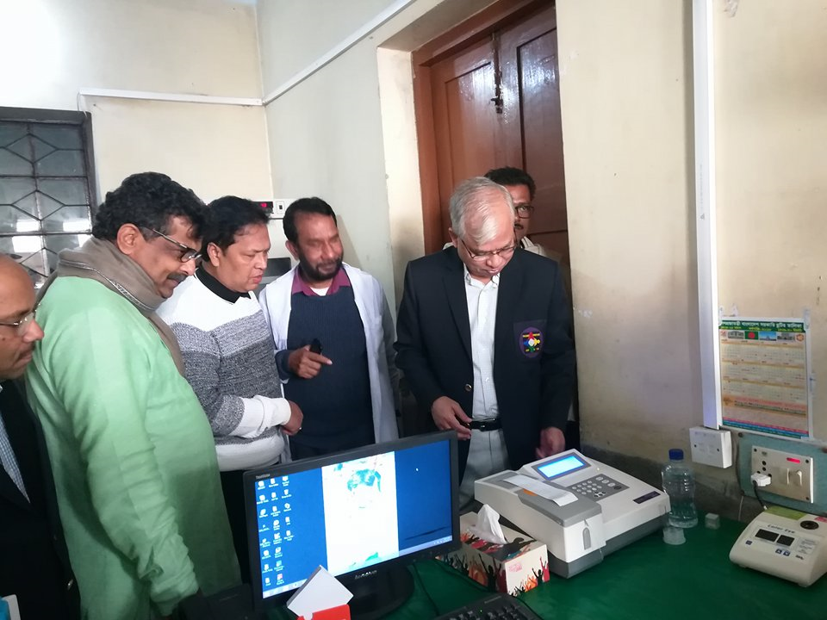

Innovative activities of Jhenaidah Sadar Hospital - 3

Slide 40




Innovative activities of Jhenaidah Sadar Hospital - 4

Slide 41




Innovative activities of Jhenaidah Sadar Hospital - 5

Slide 42




Involvement of MP, District Administrator & Mayor in Sadar Hospital

Slide 43




Involvement of district high officials in hospital activities

Slide 44




Internal Monitoring System
Meting of health improvement committee
Meting of community support group committee
QIC meeting
Monthly meeting schedule

Slide 45




Improved pediatric word by local initiative

Slide 46




Hospital Environment

Slide 47
Jhenaidah Sadar Hospital, Jhenaidah
Achievement of the Hospital
1. Active Community Participation in health service is an example in Bangldesh.
2. Improved performance of all services specially Pediatric, obstetric, operation and outdoor service.
3. Improved Cleanliness and Beautification of Campus.
4. Functioning of X-Ray service and starting of Biochemistry investigation by local initiatives.
5. Improved Security.
6. Improved Financial Management
7. Piloting of “Model District Hospital” is running in Jhenaidah Sadar Hospital.
8. The hospital is awarded 5 times from 2013 to 2017. Stood first award by 5S-KAIZEN-TQM among the 100 bedded district hospitals by defeating Norsindi Sadar Hospital.

Slide 48

Thank You
Notes:
48

Slide 49
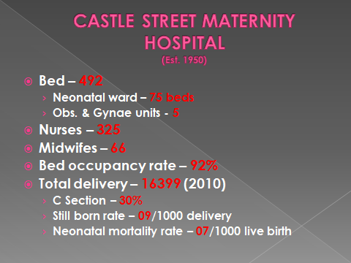
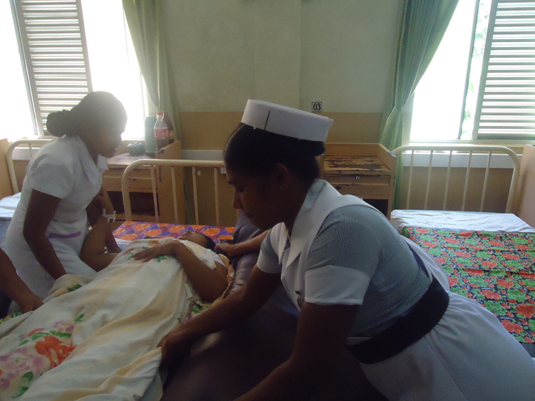
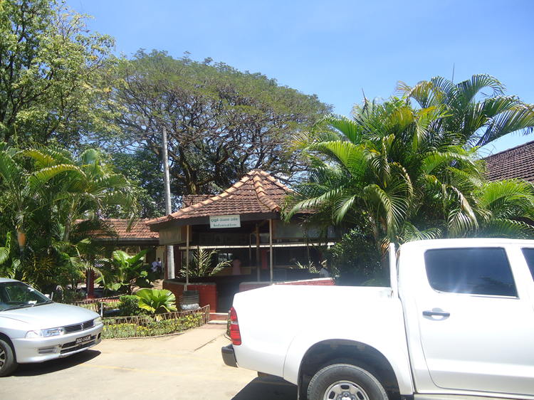
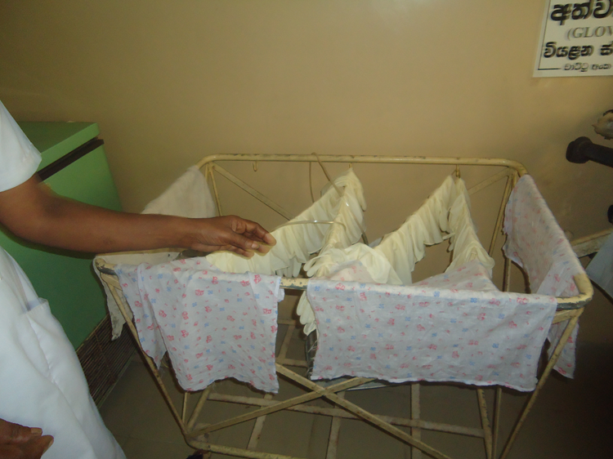
Srilanka

Slide 50
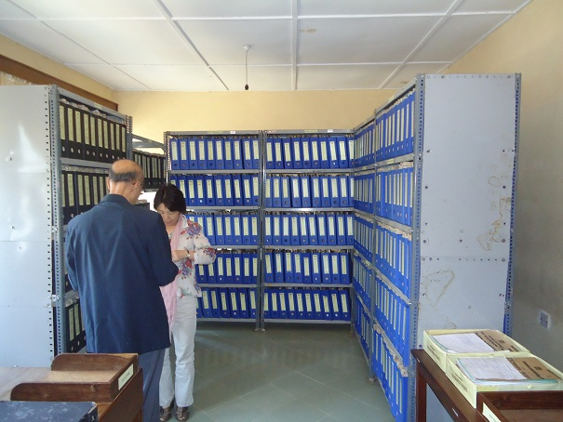
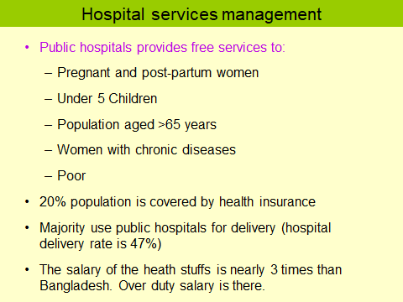
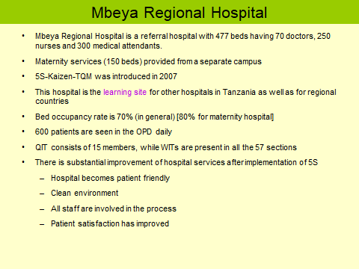
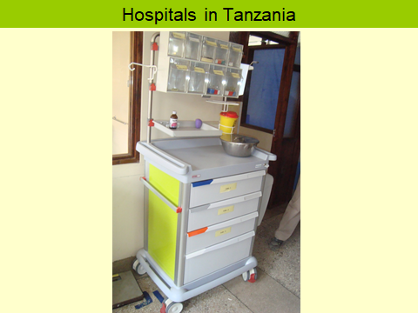
Tanzania

Slide 51
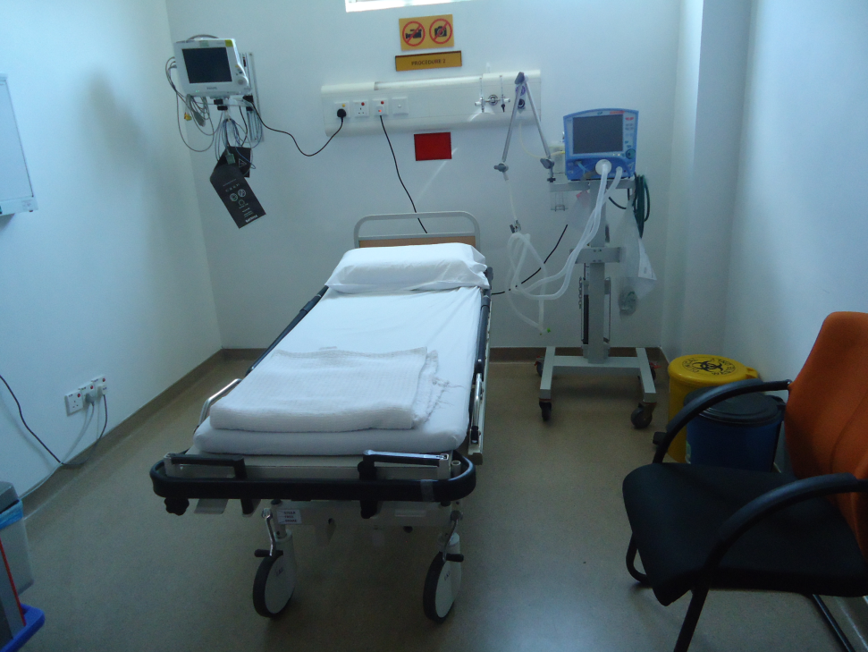
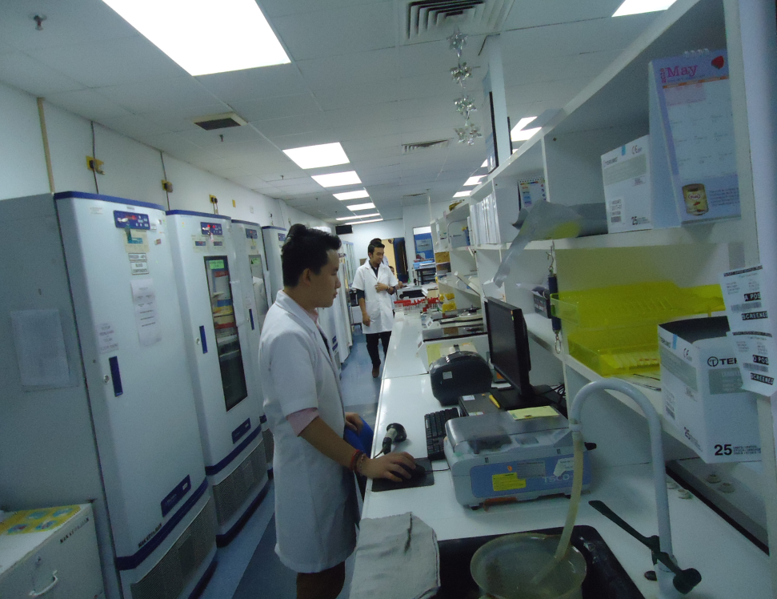
Malaysia

Slide 52
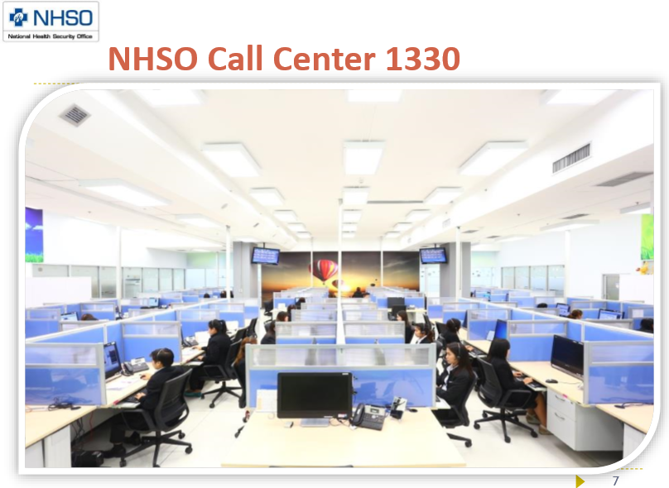
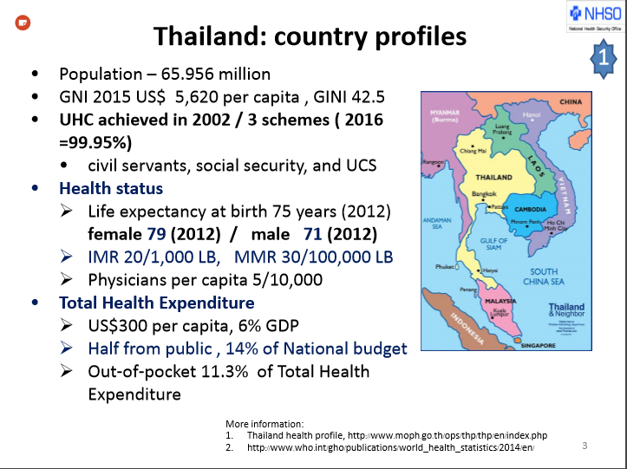
Thailand

Slide 53
Problems of The Hospital
Post of consultants of eye, anesthesia should be fulfilled immediately.
The repairing and maintenance of hospital building authority should be shifted from HED to PWD.
Oxygen plant should be repaired immediately and a manpower should be engaged.
Separation of words where the number of consultants is more than one.
Condemnation of unwanted items should be done immediately.
The campus should be cleaned.
Medical technologist lab should be appointed immediately in blood bank.

Slide 54
Activities Done
Health education in three places with community response.
Established NCD corner .
Arrangement of effective pediatric outdoor.
Digital disease profiling system in every word.
24 hours EOC service.
Effective post-natal care.
The construction work of 250 bedded has started.

Slide 55
Activities Done
Improved infection control system.
Emergency use of ECG, pulse-oxymeter, glucometer.
Everyday ultrasonography service.
Arrangement of effective training of MA by creating adaptable environment.
Established representative control system.
Established gate-pass system to control visitor.
Removal of unnecessary bill boards and improved beautification.

Slide 56
Future Plan for April
Display of health, Nutrition and population targets for the 7th FYP.
Arrangement of a new ambulance.
Cleanliness of whole campus.
Improve Patient Monitoring System by recording Pulse BP and temperature.
Reform the duty rooster of internee(MA).

Slide 57
Comparative Data of Delivery of best performing EOC center of Khulna Division in 2017
SL No | Name of institute | ANC | NVD | C. Section | Total
01. | Jhenaidah Sadar Hospital | 15360 | 1839 | 1143 | 2997
02. | 250 bed Hospital, Jessore | 13152 | 1327 | 1778 | 2967
03. | Chowgacha UHC | 18650 | 2163 | 759 | 2922
04. | Khulna Medical College Hospital | 6977 | 1455 | 1228 | 2683
05. | 250 Bedded Hospital, Kushtia | 4735 | 1595 | 919 | 2514
06. | Ad-din Hospital Jessore. | 23981 | 640 | 3075 | 3715
07. | Fatema hospital | 12417 | 239 | 929 | 1168

